Slide 1
Fabric with Service Principal Profiles

Slide 2

Service Principal Profiles
Service principal profiles are created as local accounts in Power BI Service
  Profiles API in Power BI REST APIs allows service principal to create service principal profiles
  100K limit on how many service principal profiles can be created by a single service principal
  Service principal profiles help to scale beyond 1000 workspace membership limit imposed on SPN
  Service principal profiles are unknown to Entra ID
Parent-child relationship exists between service principal and the profiles it creates
  Service principal profiles are never stand-alone – they're always associated with service principal
  Service principal profile can only be seen and used by service principal which created it
Power BI Service
profile 1
Service
Principal
profile 2
profile 3

Slide 3
API Support for Service Principal Profiles
Which APIs support service principal profiles?
  Power BI REST API
  Tabular Object Model (TOM) through XMLA endpoint
Which APIs do not support service principal profiles?
  Fabric REST APIs
  ADLS Gen2 APIs
  Any API requiring an Entra Id security principal

Slide 4
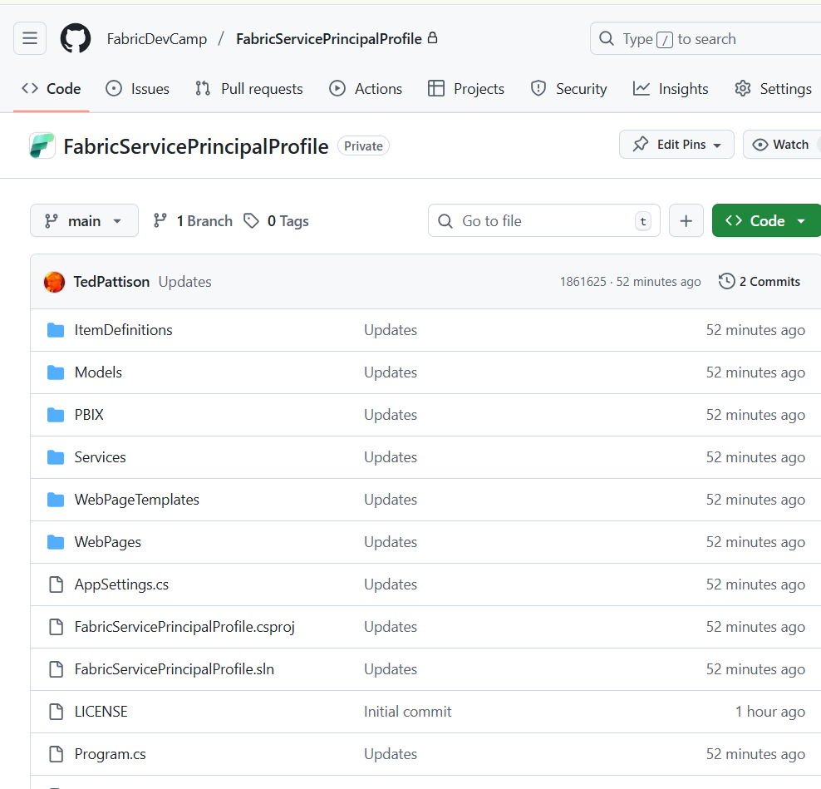
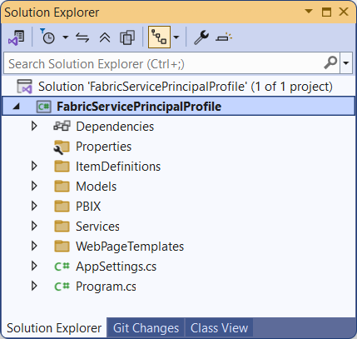
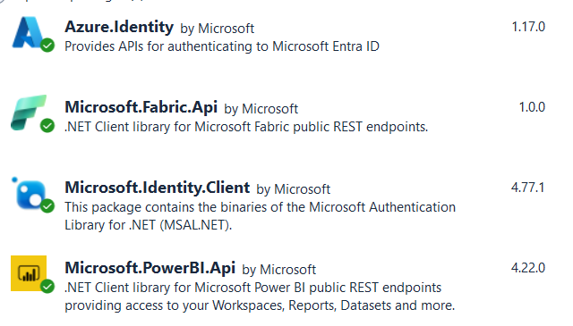
FabricServicePrincipalProfile Sample App
Available as public repo on GitHub
  https://github.com/FabricDevCamp/FabricServicePrincipalProfile

Slide 5
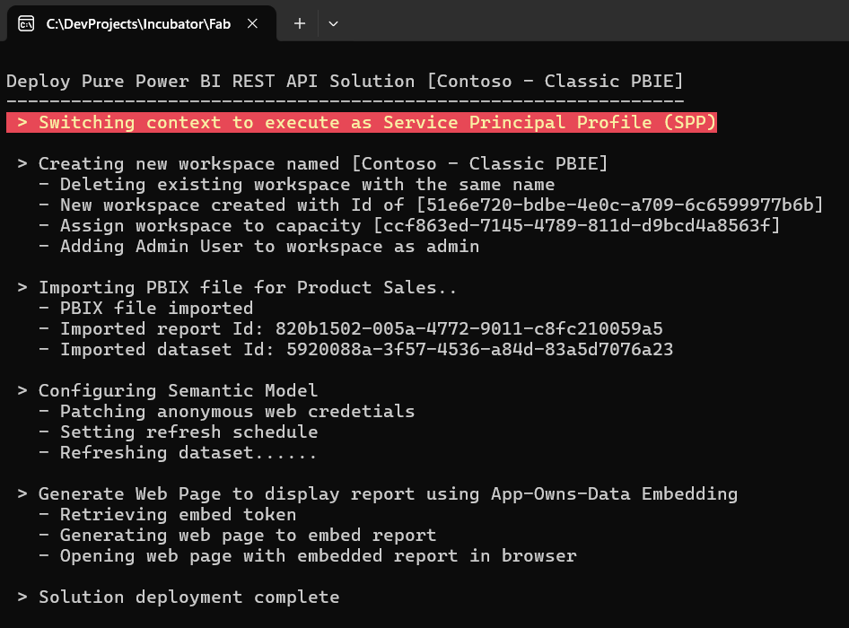
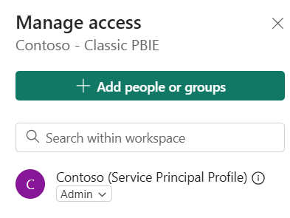
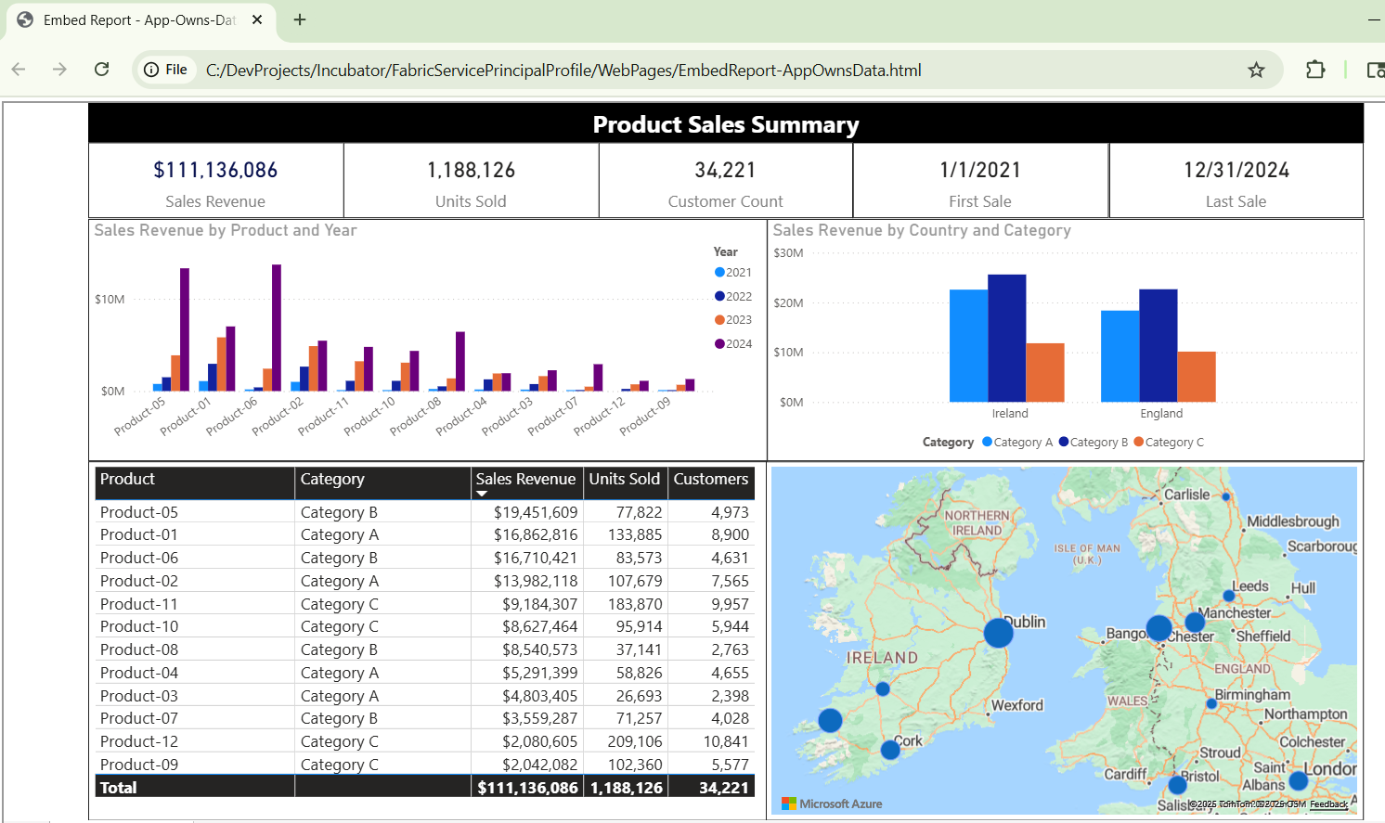
Service Principal Profiles in Classic Power BI Embedding

Slide 6
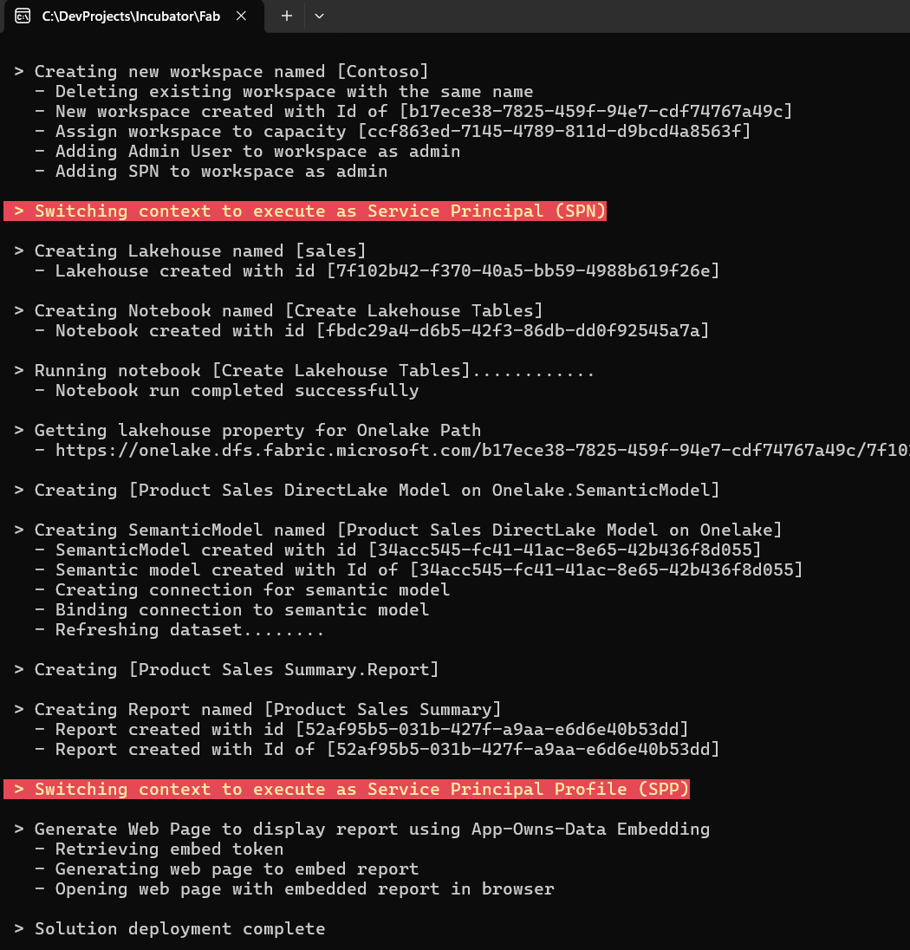
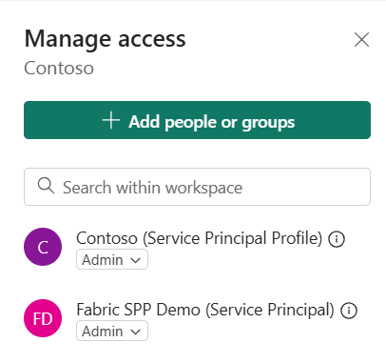
Integrating Service Principal Profiles with Fabric Content

Slide 7
Integrating Fabric Items into Power BI Embedding Projects
Opportunities
  Leverage any Fabric content in PBIE solution that can be surfaces through Power BI report
  Power BI embedding supports connecting with Direct Lake on SQL and DirectLake on Onelake
  Move away from deployment and CI-CD with PBIX and embrace benefits of TMDL and PBIR
  Take advantage of Fabric support for CI-CD using GIT integration
Challenges
  SPNs are require to create and manage most types of Fabric workspace items
  SPNs are required to create shared cloud connections (SCC)
  Scaling multitenant environment requires more SPNs
Questions
  How many SPNs are required to create and manage a specific number of workspaces?
  Are SPPs still effective at providing isolation if it is just during consumption but not provisioning

